Slide 1
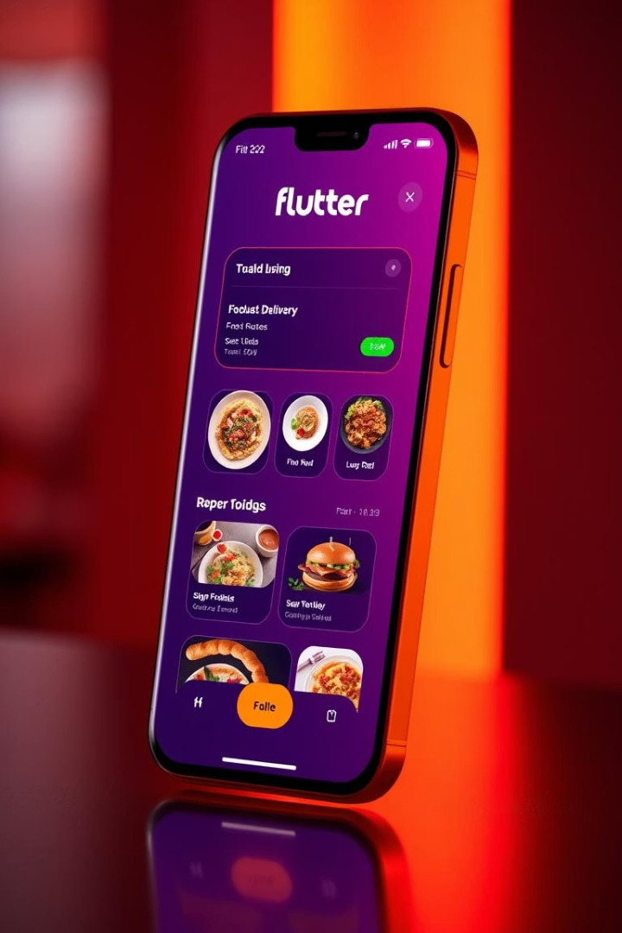
Flutter Food Delivery App
Built using Flutter, Firebase, and OpenStreetMap. This app combines modern UI with backend services.

Slide 2

Project Overview
Firebase Authentication
OpenStreetMap
Provides delivery location tracking.
Handles user login and registration.
Custom UI & Provider
Offers state management.

Slide 3

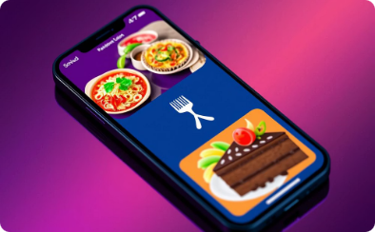


Key Features
Authentication
Food Browsing
Checkout
Delivery
Secure login and registration process.
Explore food by category.
Easy and secure checkout process.
Real-time order tracking.

Slide 4
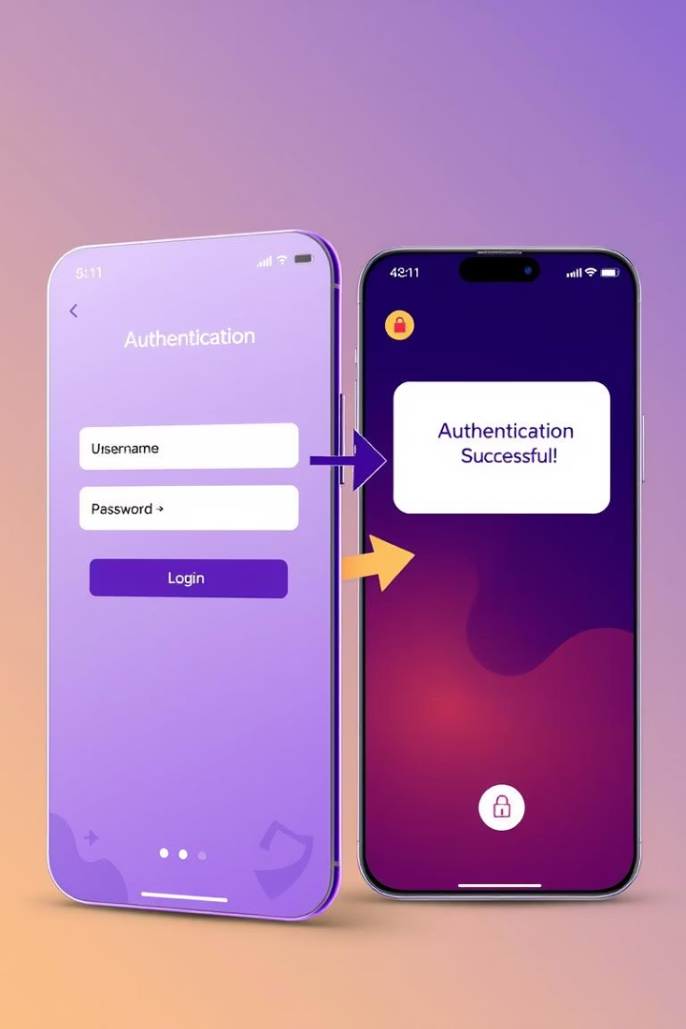
Firebase & Authentication
Firebase Authentication provides email/password login. The auth_service.dart handles login/register/logout processes.
Key Features
FirebaseAuth.instance.signInWithEmailAndPassword(
email: email,
password: password,
);
Secure authentication
Smooth user experience
Handles user sessions

Slide 5

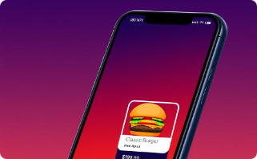




UI Components & Pages
my_button
my_food_tile
my_cart_tile
home_page.dart
Reusable button widget
Widget for displaying food items
Widget for displaying cart items
Main page of the app
food_page.dart
cart_page.dart
Page for displaying food details
Page for displaying the shopping cart

Slide 6
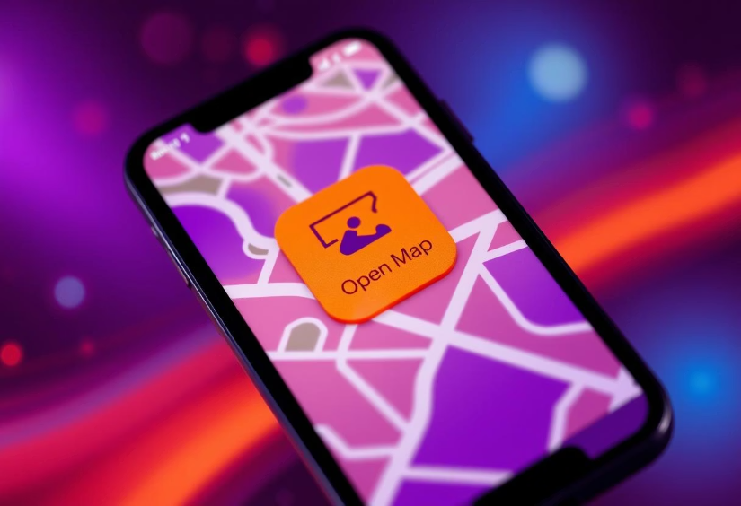
OpenStreetMap & Theming
Integrated OpenStreetMap via flutter_map for location services. my_current_location.dart fetches and displays location.
Key Features
Real-time location
Light & Dark themes
Custom theming
FlutterMap(
options: MapOptions(center: LatLng(51.5, -0.09), zoom: 13.0),
layers: [
TileLayerOptions(
urlTemplate: "https://{s}.tile.openstreetmap.org/{z}/{x}/{y}.png"
)
],
);

Slide 7

Conclusion
This app is a fully functional, scalable food delivery UI, it is built with real-world technologies and strong Flutter architecture.
Functional UI
Scalable
Tech Stack
Ready for use
Easy to extend
Firebase, Location

